Slide 1
Software Engineering
Dr. Md. Nasim Adnan

Slide 2
He had the classic look of a senior executive for a major software company—mid-40s, slightly graying at the temples, trim and athletic, with eyes that penetrated the listener as he spoke.
But what he said shocked me. “Software is dead.”
I blinked with surprise and then smiled. “You’re joking, right? The world is driven by software and your company has profited handsomely because of it. It isn’t dead! It’s alive and growing.”
He shook his head emphatically. “No, it’s dead . . . at least as we once knew it.”
I leaned forward. “Go on.”

Slide 3
He spoke while tapping the table for emphasis. “The old-school view of software—you buy it, you own it, and it’s your job to manage it—that’s coming to an end.
Today, with Web 2.0 and pervasive computing coming on strong, we’re going to be seeing a completely different generation of software. It’ll be delivered via the Internet and will look exactly like it’s residing on each user’s computing device . . . but it’ll reside on a far-away server.”
Is software really dead? If it was, you wouldn’t be reading this book!

Slide 4
Computer software continues to be the single most important technology on the world stage. And it’s also a prime example of the law of unintended consequences.
Fifty years ago no one could have predicted that software would become an indispensable technology for business, science, and engineering.
When Dijkstra married Maria in 1957, he was required as a part of the marriage rites to state his profession. He stated that he was a Programmer, which was unacceptable to the authorities, there being no such profession then in The Netherlands.

Slide 5
No one could predict that millions of computer programs would have to be corrected, adapted, and enhanced as time passed.
The burden of performing these “maintenance” activities would absorb more people and more resources than all work applied to the creation of new software.
As software’s importance has grown, the software community has continually attempted to develop technologies that will make it easier, faster, and less expensive to build and maintain high-quality computer programs.

Slide 6


Slide 7
The Nature of Software
Today, software takes on a dual role. It is a product, and at the same time, the vehicle for delivering a product. As a product, it delivers the computing potential embodied by computer hardware or more broadly, by a network of computers that are accessible by local hardware.
Whether it resides within a mobile phone or operates inside a mainframe computer, software is an information transformer—producing, managing, acquiring, modifying, displaying, or transmitting information that can be as simple as a single bit or as complex as a multimedia presentation derived from data acquired from dozens of independent sources.

Slide 8
As the vehicle used to deliver the product, software acts as the basis for the control of the computer (operating systems), the communication of information (networks), and the creation and control of other programs (software tools and environments).
Software delivers the most important product of our time—information. It transforms personal data (e.g., an individual’s financial transactions) so that the data can be more useful in a local context; it manages business information to enhance competitiveness; it provides a gateway to worldwide information networks (e.g., the Internet), and provides the means for acquiring information in all of its forms.

Slide 9
Today, a huge software industry has become a dominant factor in the economies of the industrialized world. Teams of software specialists, each focusing on one part of the technology required to deliver a complex application, have replaced the lone programmer of an earlier era.
And yet, the questions that were asked of the lone programmer are the same questions that are asked when modern computer-based systems are built:

Slide 10
Why does it take so long to get software finished?
Why are development costs so high?
Why can’t we find all errors before we give the software to our customers?
Why do we spend so much time and effort maintaining existing programs?
Why do we continue to have difficulty in measuring progress as software is being developed and maintained?

Slide 11
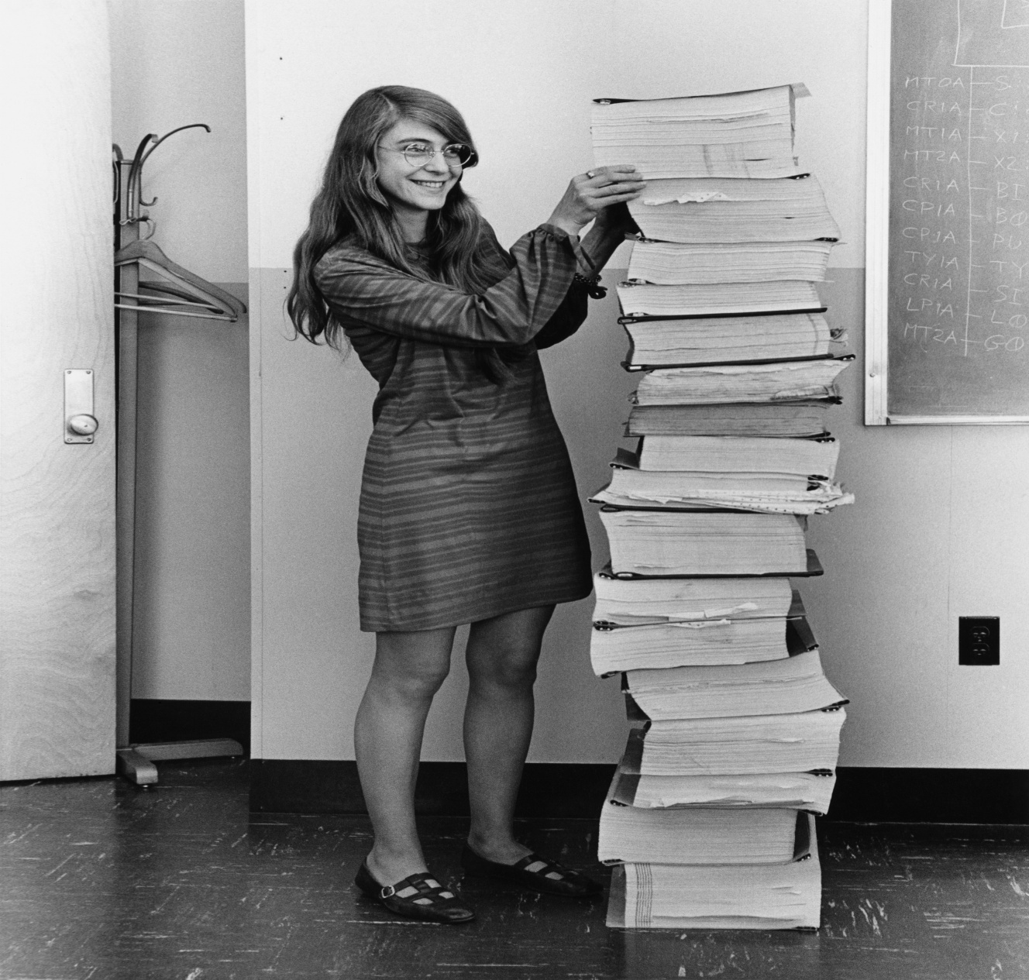
Margaret Hamilton in 1969, standing next to listings of the software she and her MIT team produced for the Apollo project.

Slide 12
Defining Software
Software is:
(1) instructions (computer programs) that when executed provide desired features, function, and performance;
(2) data structures that enable the programs to adequately manipulate information, and
(3) descriptive information in both hard copy and virtual forms that describes the operation and use of the programs.

Slide 13
Software has characteristics that are considerably different than those of hardware:
Software is developed or engineered; it is not manufactured in the classical sense
Software doesn’t “wear out.
Although the industry is moving toward component-based construction, most software continues to be custom built.

Slide 14
The next Figure depicts failure rate as a function of time for hardware. The relationship, often called the “bathtub curve,” indicates that hardware exhibits relatively high failure rates early in its life (these failures are often attributable to design or manufacturing defects); defects are corrected and the failure rate drops to a steady-state level (hopefully, quite low) for some period of time.
As time passes, however, the failure rate rises again as hardware components suffer from the cumulative effects of dust, vibration, abuse, temperature extremes, and many other environmental maladies. Stated simply, the hardware begins to wear out.

Slide 15
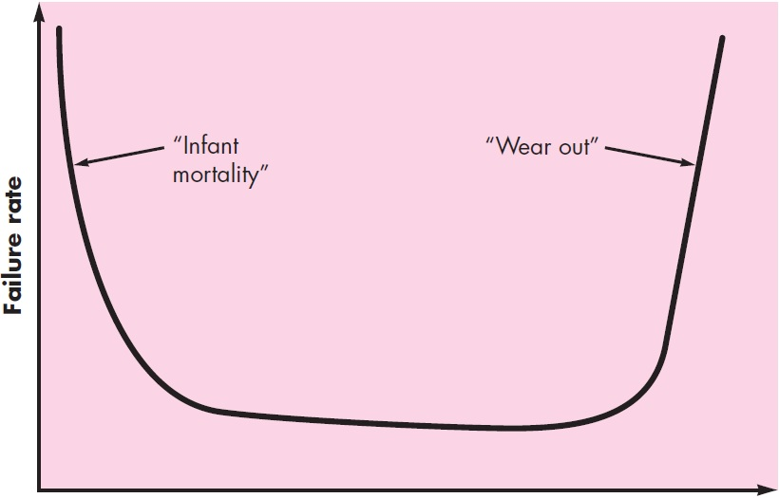

Slide 16
Software is not susceptible to the environmental maladies that cause hardware to wear out. In theory, therefore, the failure rate curve for software should take the form of the “idealized curve” shown in the next Figure.
Undiscovered defects will cause high failure rates early in the life of a program. However, these are corrected and the curve flattens as shown.
The idealized curve is a gross oversimplification of actual failure models for software.
However, the implication is clear—software doesn’t wear out. But it does deteriorate!

Slide 17
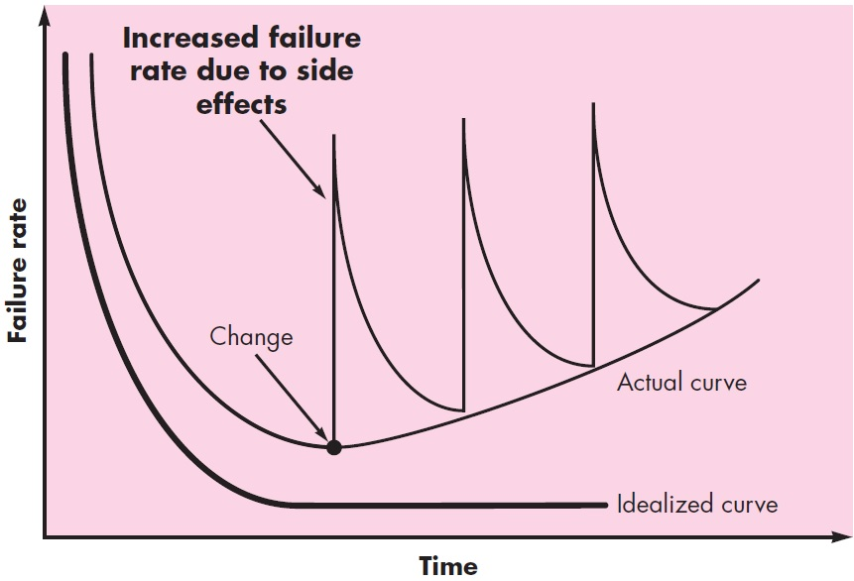

Slide 18
As changes are made, it is likely that errors will be introduced, causing the failure rate curve to spike as shown in the “actual curve”.
Before the curve can return to the original steady-state failure rate, another change is requested, causing the curve to spike again.
Slowly, the minimum failure rate level begins to rise—the software is deteriorating due to change.

Slide 20
Software Application Domains
System Software
Application Software
Engineering/Scientific Software
Embedded Software
Product-line Software
Web Applications
Artificial Intelligence Software

Slide 21
Software Engineering
In order to build software that is ready to meet the challenges of the twenty-first century, you must recognize a few simple realities:
It follows that a concerted effort should be made to understand the problem before a software solution is developed.
The information technology requirements demanded by individuals, businesses, and governments grow increasingly complex with each passing year (Income Tax). It follows that design becomes a pivotal activity.

Slide 22
The hardest thing in the world to understand is the income tax. – Albert Einstein

Slide 23
Individuals, businesses, and governments increasingly rely on software for strategic and tactical decision making as well as day-to-day operations and control. If the software fails, people and major enterprises can experience anything from minor inconvenience to catastrophic failures. It follows that software should exhibit high quality. (Stock is Okay)
As the perceived value of a specific application grows, the likelihood is that its user base and longevity will also grow. As its user base and time-in-use increase, demands for adaptation and enhancement will also grow (SAP). It follows that software should be maintainable.

Slide 24
All these realities lead to one conclusion: software in all of its forms and across all of its application domains should be engineered. And that leads us to the topic of this book—software engineering.
Although hundreds of authors have developed personal definitions of software engineering, a definition proposed by Fritz Bauer still serves as a basis for discussion:
[Software engineering is] the establishment and use of sound engineering principles in order to obtain economically software that is reliable and works efficiently on real machines.

Slide 25
Footnote
DSS
Relates to long-range planning
Human resources changes
MIS
Known to us all
Monthly/Yearly Sales analysis
DPS
Enforce day to day rules and regulations of a business
Employee absence sheet, current stock of products

Slide 26
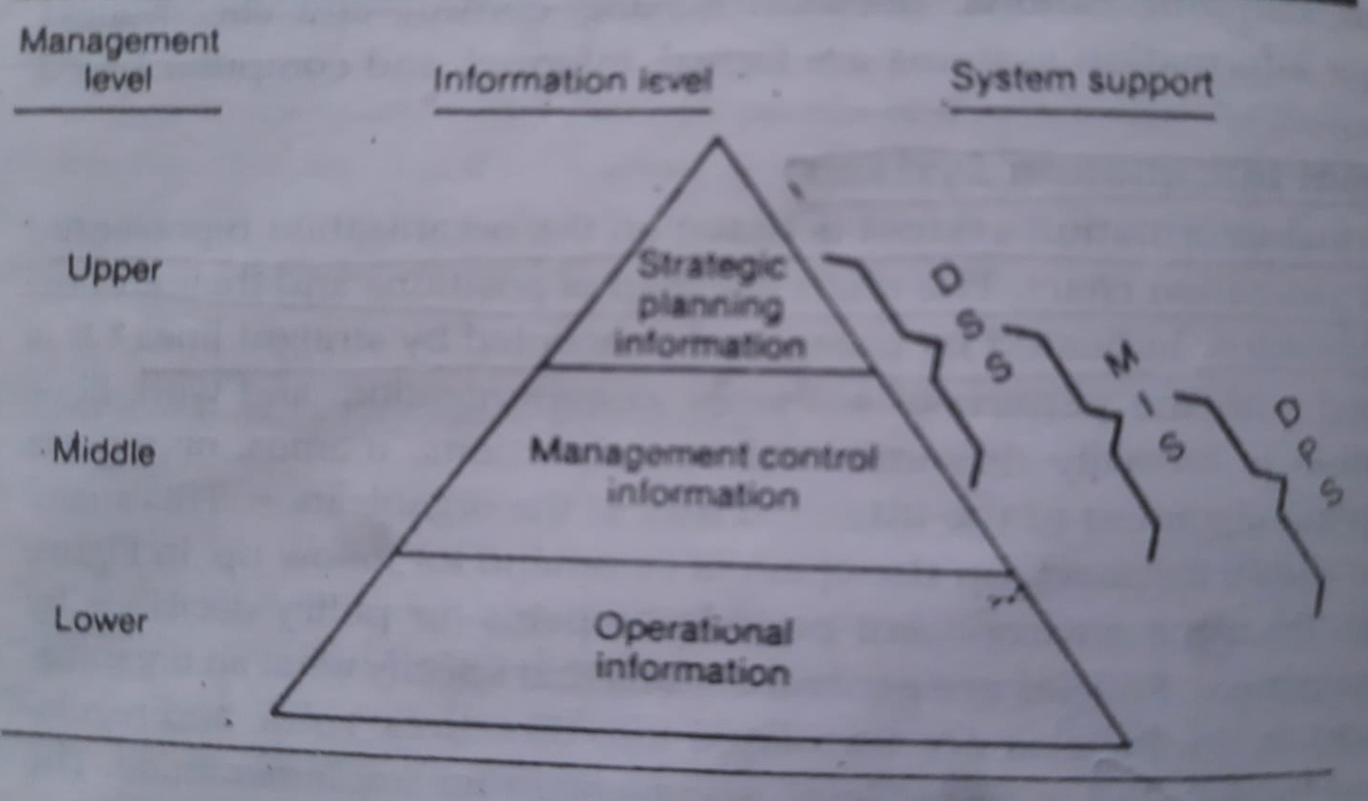

Slide 27
Focus Area: MIS
A key element of MIS is the database. MIS cannot be implemented effectively without the help of a database
A database is a nonredundant collection of interrelated data items that can be accessed through application programs and available to many users

Slide 28
Decision Making
Elements?

Slide 29
Decision Making
MIS – consolidates day to day transaction
Production MIS
Personnel MIS
Measures are consolidated according to Dimensions
DSS – in my own view: results from all the available MIS systems, available external data …

Slide 30
The Software Process
A process is a collection of activities, actions, and tasks that are performed when some work product is to be created.
An activity strives to achieve a broad objective (e.g., communication with stakeholders) and is applied regardless of the application domain, size of the project, complexity of the effort, or degree of rigor with which software engineering is to be applied.
An action encompasses a set of tasks that produce a major work product (e.g., an architectural design model).
A task focuses on a small, but well-defined objective (e.g., conducting a unit test) that produces a tangible outcome.

Slide 31
In the context of software engineering, a process is not a rigid prescription for how to build computer software.
Rather, it is an adaptable approach that enables the people doing the work (the software team) to pick and choose the appropriate set of activities, actions, and tasks.
The intent is always to deliver software in a timely manner and with sufficient quality to satisfy those who have sponsored its creation and those who will use it.

Slide 32
Process Framework
A generic process framework for software engineering encompasses five activities:
Communication. Before any technical work can commence, it is critically important to communicate and collaborate with the customer (and other stakeholders).
The intent is to understand stakeholders’ objectives for the project and to gather requirements that help define software features and functions.

Slide 33
Planning. Any complicated journey can be simplified if a map exists. A software project is a complicated journey, and the planning activity creates a “map” that helps guide the team as it makes the journey.
The map—called a software project plan—defines the software engineering work by describing the technical tasks to be conducted, the risks that are likely, the resources that will be required, the work products to be produced, and a work schedule. (Padma Bridge)

Slide 34
Modeling. Whether you’re a landscaper, a bridge builder, an aeronautical engineer, a carpenter, or an architect, you work with models every day. You create a “sketch” of the thing so that you’ll understand the big picture—what it will look like architecturally, how the constituent parts fit together, and many other characteristics.
If required, you refine the sketch into greater and greater detail in an effort to better understand the problem and how you’re going to solve it.
A software engineer does the same thing by creating models to better understand software requirements and the design that will achieve those requirements.

Slide 35
Construction. This activity combines code generation (either manual or automated) and the testing that is required to uncover errors in the code.
Deployment. The software (as a complete entity or as a partially completed increment) is delivered to the customer who evaluates the delivered product and provides feedback based on the evaluation.

Slide 36
As discussed previously, a generic process framework for software engineering defines five activities—communication, planning, modeling, construction, and deployment.
We now describe the principles that focus on software engineering as a whole.

Slide 37
The First Principle: The Reason It All Exists
A software system exists for one reason: to provide value to its users.
All decisions should be made with this in mind. Before specifying a system requirement, before noting a piece of system functionality, before determining the hardware platforms or development processes, ask yourself questions such as: “Does this add real value to the system?”
If the answer is “no,” don’t do it. All other principles support this one.

Slide 38
The Second Principle: KISS (Keep It Simple, Stupid!)
Software design is not a haphazard process. There are many factors to consider in any design effort.
All design should be as simple as possible.
This facilitates having a more easily understood and easily maintained system.

Slide 39
The Third Principle: Maintain the Vision
A clear vision is essential to the success of a software project.
Without one, a project almost unfailingly ends up being “of two [or more] minds” about itself.
Without conceptual integrity, a system threatens to become a patchwork of incompatible designs. (Backword Compatibility)

Slide 40
The Fourth Principle: What You Produce, Others Will Consume
Seldom is an industrial-strength software system constructed and used in a vacuum.
In some way or other, someone else will use, maintain, document, or otherwise depend on being able to understand your system.
So, always specify, design, and implement knowing someone else will have to understand what you are doing.

Slide 41
The audience for any product of software development is potentially large.
Specify with an eye to the users. Design, keeping the implementers in mind. Code with concern for those that must maintain and extend the system. Someone may have to debug the code you write, and that makes them a user of your code.
Making their job easier adds value to the system.

Slide 42
The Fifth Principle: Be Open to the Future
A system with a long lifetime has more value. In today’s computing environments, where specifications change on a moment’s notice and hardware platforms are obsolete just a few months old, software lifetimes are typically measured in months instead of years.
However, true “industrial-strength” software systems must endure far longer.
To do this successfully, these systems must be ready to adapt to changes. Systems that do this successfully are those that have been designed this way from the start.

Slide 43
The Sixth Principle: Plan Ahead for Reuse
Reuse saves time and effort. Achieving a high level of reuse is arguably the hardest goal to accomplish in developing a software system.
The reuse of code and designs has been proclaimed as a major benefit of using object-oriented technologies.
However, the return on this investment is not automatic. To leverage the reuse possibilities that object-oriented [or conventional] programming requires forethought and planning.

Slide 44
The Seventh principle: Think!
This last principle is probably the most overlooked. Placing clear, complete thought before action almost always produces better results.
When you think about something, you are more likely to do it right.

Slide 45
